Slide 1
Preparing for the Impact of Economic Development
An Update from the Community Research and Grants Management Department of The Columbus Foundation
Notes:
The Columbus Foundation is a grantmaking financial institution. But it would not be able to fulfill its commitment to the most effective philanthropy without a deep understanding of community needs, challenges, and opportunities. This is why the Community Research and Grants Management department exists, and it is why the foundation supports a variety of community research initiatives. To us, this is what it means to work alongside our partners to be an informed community that is ready for the future.

Slide 2
The Role of Community Research
Notes:
Having produced or relied upon research reports throughout my career, I can confirm that many reports do in fact end up collecting dust on book shelves. But research studies, reports, and plans often help us better understand our strengths, weaknesses, challenges, opportunities, inequities, threats, and possibilities. Research can help us plan, prepare, celebrate points of pride, sound alarm bells, define goals, and clarify vision.
Studies and reports can go viral, inspire movements and collective action, and set multi-year policy agendas. Sometimes such reports can come from within our community, and sometimes it’s the research that comes from outside the community that helps us see something more clearly that we’ve overlooked or taken for granted. In any case, research has the power to not only inform, but move our community forward to a more equitable, inclusive, prosperous, and sustainable future.

Slide 3
Research Supported in 2023
AECOM, Tech Firm Community Commitments
All Aboard Ohio, The Economic Impact of the 3C-D Passenger Rail Corridor
Health Policy Institute of Ohio, Unlocking Ohio’s economic potential: The impact of eliminating racial disparities on Ohio businesses, governments and communities
Human Service Chamber & Greater Columbus Arts Council, The Economic Impact of Human Services and Arts Nonprofits
Mental Health & Addiction Advocacy Coalition + Multiethnic Advocates for Cultural Competence, Inc. + Central State University and Ohio University, Behavioral Health in Ohio: Improving Data, Moving Toward Racial and Ethnic Equity
Mid-Ohio Regional Planning Commission, Development of a Community Data Dashboard
The Women’s Fund of Central Ohio, Research Update on the Region’s Gender and Racial Wealth Gap
Notes:
This is why we seek not only to fund research projects, but to gather, learn from, and contextualize data and research on various subjects and geographic levels to constantly be updating and refining our collective understanding of the community. To give you an idea of the wide variety of research topics and subject matter experts we support, here is a list of the projects and initiatives The Columbus Foundation has supported in just the past year.

Slide 4
Notes:
We all probably remember when the news about Intel broke last January. Depending on your proximity to the site or how tangential you were to the work, there may have been excitement, dread, but two things were certain: we knew it would be big, and we knew there was a lot we didn’t know about how it happened and how it will affect the future of the region.

Slide 5
Notes:
So to begin seeking an understanding of what central Ohio could expect to unfold next, and probably even more so to begin contemplating what it will look like to be ready for whatever may lie ahead, The Columbus Foundation commissioned internationally acclaimed civil engineering firm, AECOM, to gather data about regions around the country with a concentrated semiconductor industry, and how the development of similar manufacturing facilities has impacted those places.

Slide 6
Purpose and Approach
Ready…
The need to mobilize and take our new growth potential serious.
How can we make the most of this opportunity for everyone in the region?
Equity & inclusion.
Regional collaboration & partnership.
Long-term strategic thinking & planning.
Considering potential scenarios and not being afraid to think big(ger).
Notes:
We approached the research process with a focus on shared community values, and with a long-term view of what it would look like to work collaboratively across the region to prepare for the future.

Slide 7
Intel Impact Study Overview
Key Questions
What are the impacts of similar facilities in other parts of the US to the semiconductor plants being built in the Columbus region?
How have other regions addressed these impacts?
How have other regions leveraged the opportunities that accompany these investments?
What are the major potential impacts of Intel’s investment to the immediate area, and the region more broadly?
How can negative impacts and challenges be mitigated or turned into opportunities?
How can the region use this investment as a catalyst for better, smarter growth and development?
How can the Intel investment be leveraged to improve quality of life for all residents?
Notes:
We framed questions around what could be known about the impact of semiconductor manufacturing hubs in order to project what might reasonably be expected to unfold here.

Slide 8
Impact Areas
Impact of Intel
Population & Housing
Education & Workforce
Economy & Employment
Transportation & Land Use
Environment
How will the development of Intel chip fabs impact the region across various domains?
How will a new wave of more recent and future economic development announcements add to or compound the effects to these domains?
Notes:
And we considered the comprehensive nature of impact that could take place over the coming years and decades, and even what subsequent wave of economic development decisions and investments could be made in the months that followed Intel’s announcement.

Slide 9
Top 10 Cities for Semiconductor Manufacturing Jobs
San Jose, CA
Hillsboro, OR (Portland MSA)
Chandler, AZ (Phoenix MSA)
Dallas, TX
Austin, TX
Malta, NY (Albany MSA)
Bloomington, MN (Minneapolis MSA)
Durham, NC (Raleigh-Durham MSASs)
Boise, ID
Notes:
AECOM’s team of industry experts from across the country identified other places that central Ohio could learn from, selecting a subset of these communities that are most similar to the Columbus MSA for deeper analysis.

Slide 10
Takeaways
Education & Workforce
Transportation & Land Use
Economy & Employment
Environment
Population & Housing
Notes:
The takeaways reflect the full spectrum of potential community impact, along with cautionary tales and best practices for how our region could work together to leverage major new investments while minimizing negative impact to crucial systems such as the region’s housing market, transportation networks, natural resources, and educational and employment landscapes.

Slide 11
Strategies and Opportunities
Regional partnerships
Partner with Intel
Design for equity through community engagement and social infrastructure
Build a strategy for welcoming and including new residents
Revisit community plans, zoning codes, and development standards
Incentivize private sector residential development to build missing housing products at higher density
Cultivate and promote an ‘entrepreneurial ecosystem’
Offer grants and technical assistance to support local business growth
New partnerships with educational institutions at all levels across the region
Public-private partnerships to support training and upskilling for careers in tech
Increase access to multiple modes of transportation through TOD and shared-use trails
Address ‘last mile’ transportation challenges
Form new regional transit and mobility partnerships
Protect and enhance wetlands, green space, and the tree canopy
Incentivize conversion to renewable energy, low-impact development, and on-site energy generation
Notes:
AECOM’s research identified a host of strategies and opportunities for the region to consider, with partnership and collaboration at the heart of nearly every promising approach that could be taken. Thankfully, many of the strategies put forth in this research are already underway, thanks in large part to prudent, action-oriented partners like the Mid-Ohio Regional Planning Commission, the Central Ohio Regional Transit Authority, One Columbus, and the collective of Licking County civic and business leaders that came together to contemplate the best ways forward.

Slide 12
Tech Firm Community Commitment Case Studies
Intel
Chandler, AZ
Hillsboro, OR
Apple
Cupertino, CA
Microsoft
Seattle, WA
Google
Mountainview, CA
General Electric
New York, Connecticut, Massachusetts
Charter Communications
Stamford, CT
Micron
New York
Notes:
In order to better understand what it could look like to forge a meaningful, mutually beneficial, long-term partnership with Intel and any other large firms that may now choose to co-locate in central Ohio, the AECOM team also conducted a first-of-its kind assessment of tech firm community commitments, including case studies on some of the most relevant companies and regions around the country.

Slide 13
Tech Firm Community Commitment Best Practices & Lessons Learned
Deal Structure
Efficient Incentivization
Partnerships
Implementation
Summary
Lessons for Central Ohio
Catalyzing Economic Opportunity
No other known database exists to track comprehensive public economic incentive packages granted to firms, or commitments to communities by major private organizations.
AECOM identified 39 examples (including multiple commitments by the same firm) for the analysis, based on:
order of magnitude in total dollar amount
relevance to central Ohio
available data
Notes:
They built a database of 39 examples of corporate incentive packages and community investments with publicly available data about what drew those companies to those regions, and what commitments they have made to the benefit of local residents and workers. We’ll be sharing all of this research on the reports section of our website.

Slide 14
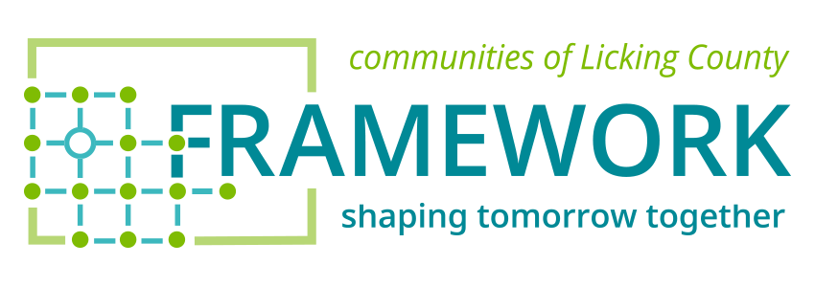
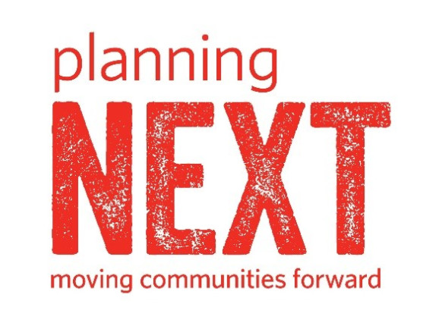
Sponsored by The Thomas J. Evans Foundation
Notes:
https://frameworklc.org/resources/
I want to conclude by highlighting two other local research and planning efforts that have been underway. The first is the Framework initiative, sponsored by the Thomas J. Evans Foundation, chaired by Sarah Wallace and largely facilitated by the local firm, planningNEXT. In addition to the immense body of data and research compiled in the final report now available on the Framework website, this effort was really the first time this group of Licking County stakeholders have come together to contemplate together the future of their communities, as well as their relationship to the broader region and state.

Slide 15
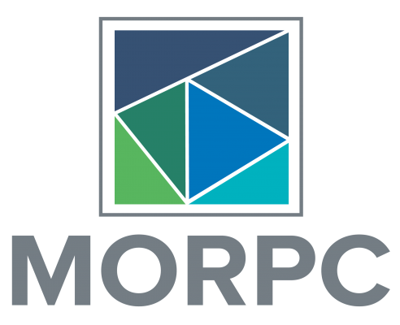
Mid-Ohio Regional Planning Commission Updated Population Projections
Notes:
https://experience.arcgis.com/experience/cd446109151f474db74b13fa0795023c/page/County-Forecasts/
The second is the work of the Mid-Ohio Regional Planning Commission to update the region’s population projections in light of the major economic development announcements of the past two years. In both cases, this is the difficult but vital work of bringing people together, and avoiding mere speculation in order to make truly informed and wise decisions about how we can proceed together as a region in order to become a more equitable and sustainable place for everyone in central Ohio.

Slide 16
Thank You!
Matthew Martin, Director of Community Research The Columbus Foundation
Notes:
This same spirit is behind our support for the local community research ecosystem, and we hope you find it to be a helpful additive to your own philanthropy as well. Thank you, and now please welcome today’s guest panelists.

